Slide 1


GASB’s OPEB Changes - Will they impact public sector health care benefits?
November 7, 2014
Eric Gary, FSA, FCA, MAAA
Chief Health Actuary

Slide 2
Agenda
Background
How is it like GASB 67/68?
How is it different from GASB 67/68?

Slide 3
Timing
Exposure drafts released on 5/28/2014.
Comment deadline was 8/29/2014.
Public hearings held in September 2014.
Target date for final statements is June 2015.
Proposed effective dates:
  Plans: Fiscal years on or after 12/15/2015
  Employers: Fiscal years on or after 12/15/2016

Slide 4
New GASB Standards for OPEB
Plans
  Project No. 34-1P: Financial Reporting for Postemployment Benefit Plans Other Than Pension Plans
Employers
  Project No. 34-1E: Accounting and Financial Reporting for Postemployment Benefits Other Than Pensions
Very similar to GASB 67/68 pension changes
Notes:
34-1P is 190 pages
34-1E is 77 pages

Slide 5
Similar to GASB 67/68
Net OPEB Liability (NOL) moves to balance sheet of employers. NOL is:
  Actuarial accrued liability (referred to in statements as Total OPEB Liability or TOL) based on Entry Age Normal funding method, less
  Plan’s Fiduciary Net Position (market value of assets).
Discount rate is a blended single rate that is the equivalent of the long-term rate while assets are available and a municipal bond index for the remaining period.
  Many OPEB plans already using a “blended rate,” although more loosely defined.

Slide 6
Similar to GASB 67/68
Entry Age Normal (EAN) level percent of pay cost method. Method said to be chosen to enhance comparability.
OPEB Expense
  EAN normal cost
  Interest on the NOL
  Immediate recognition of changes in active and inactive liability due to plan amendments
  Deferred recognition (over average remaining service life) of changes in active and inactive liability due to assumption changes and actual experience
  Deferred recognition of investment gains and losses over five years
Deferred inflows/outflows

Slide 7
Similar to GASB 67/68
Cost sharing employers will need to report proportionate share of NOL, OPEB expense and deferred inflows and outflows.
Must account for special funding situations when a
non-employer contributing entity is present.
Extensive footnote disclosure and supplementary information required. 10-year schedules of many items.

Slide 8
OPEB-Specific Items
Costs
  Changes consistent with recent changes to actuarial standards of practice (ASOPs)
    Dropped GASB 43/45’s reference to “community rated” cost basis.
    Reference to “include certain taxes” (e.g., PPACA’s High Cost Plan Excise Tax or “Cadillac Tax”).
  ASOP No. 6: Measuring Retiree Group Benefits Obligations and Determining Retiree Group Benefits Program Periodic Costs or Actuarially Determined Contributions
    Provides guidance for coordinating and integrating all of the elements of an actuarial valuation of a retiree group benefits program.
    Effective for any actuarial work product with a measurement date on or after March 31, 2015.

Slide 9
OPEB-Specific Items
Claims costs
  Pooled Health Plans
    The actuary should reflect the full age-specific cost, including the implicit subsidy.
      The value of the employer’s benefit commitment is independent of the method used to provide the benefit.
      Results in a more appropriate representation of the employer’s long-term liabilities for retirees as there is no guarantee that the current premium structure or the pooled health plan will continue over the long-term nor that the employer will continue or be allowed to continue in the pool.
    The actuary should use age-specific costs based upon the pooled health plan’s total age distribution and the pooled health plan’s total expected claims costs.
      Distribution table for the total number of covered health plan members by age, or by age and gender, provided by the pooled health plan.
      If pooled health plan information is not available, the actuary may make a reasonable assumption regarding the pooled health plan’s age/gender distribution.

Slide 10
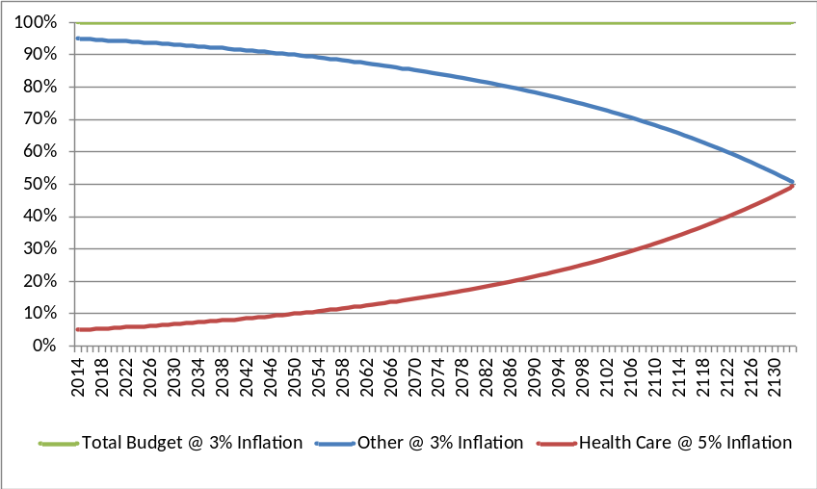
OPEB-Specific Items
Claims costs
  Cadillac Tax
    “Projected benefit payments also should include taxes or other assessments expected to be imposed on benefit payments…”
    Impact to long-term trend assumption

Slide 11
OPEB-Specific Items
Claims costs
  Subsidies
    “[P]rojected benefit payments should not be reduced by subsidies expected to be received for making benefit payments other than those received for providing Medicare benefits.”
    Technical Bulletin No. 2006-1 still applies.

Slide 12
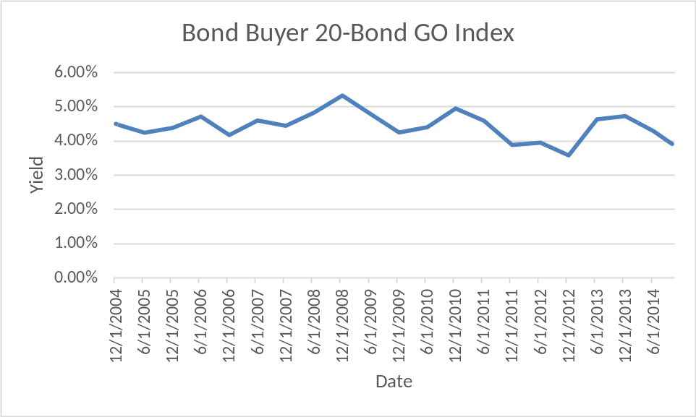
OPEB-Specific Items
Discount Rate
  Pay-as-you-go: Index rate for high-quality 20-year tax exempt bond (AA/Aa or higher).
  Generally speaking, OPEB plans are not as well funded.
    Potential volatility in discount rate assumption.

Slide 13
OPEB-Specific Items
Discount Rate
  Experience study needed, if funded.
  Disclosures
    Long-term expected real rate of return for each major asset class.
    Money-weighted returns.

Slide 14
OPEB-Specific Items
Sensitivity disclosures
  +/- 1% discount rate
  +/- 1% health trend
  Total of 9 NOL measurements.
 |  | Rate of Investment Return
 |  | +1% | 0% | -1%
Trend | +1% | 1 | 2 | 3
 | 0% | 4 | 5 | 6
 | -1% | 7 | 8 | 9

Slide 15
OPEB-Specific Items
Entry age actuarial cost method (level % of pay)
  OPEBs are often not salary-based
  Payroll data
    Availability
    Comparability to pension data
    Volunteer plans
  Projections back to entry age
    Salary
    Benefits
  Negative normal costs
    Disability plans

Slide 16
OPEB-Specific Items
Valuations required every two years.
  GASB 43/45 allows three-year valuation cycle if fewer than 200 participants.
Alternative Measurement Method (AMM) is still an option.
  Less than 100 plan members (actives and retirees).
  Special footnote requirements.
  Model inputs more formulaic.
  Turnover should be derived from U.S. Office of Personnel Management data of the employee group covered by the Federal Employees Retirement System.

Slide 17
Stay In Touch
GASB website
  www.GASB.org
Live Meeting Webcasts
  GASB Board meetings available via live video/audio.
    Next meeting is November 11, 2014.

Slide 18
Questions?

