Slide 1
MAPERS 2012 Conference
GASB Update
July 12, 2012
Presented by:
Thomas J. Cavanaugh, FSA, FCA, MAAA, EA
CEO
Cavanaugh Macdonald Consulting, LLC

Slide 2
Why are there GASB standards?
Ultimately, the Governmental Accounting Standards Board is concerned with how state and local governments present accounting and financial information
Reasons behind GASB changes
  Improve consistency and transparency
  Enhance decision usefulness of pension information
  Assist users in evaluating accountability and inter-period equity related to pensions
GASB’s authority extends only to accounting and financial reporting, not to funding

Slide 3
Governmental Accounting Standards Board
Revised Statements 25 and 27
Statement
Standard
25 (now 67)
Financial Reporting for Pension Plans
27 (Now 68)
Accounting and Financial Reporting for Pensions

Slide 4
Original GASB Statement No. 25
Required Reporting for Defined Benefit
Pension Plans
Statement of Net Assets Available for Benefits
Statement of Changes in Net Assets Available for Benefits
Schedule of Funding Progress
Schedule of Employer Contributions
Notes to Financial Statements

Slide 5
Original GASB Statement No. 25
Basis of Calculations
Biennial valuations
Use of funding methods and assumptions
Include all benefits in liabilities
Assumptions follow ASOP No. 4
Consistent inflation assumption
Acceptable funding method
Market-related asset valuation method
30-year maximum UAL amortization period

Slide 6
Original GASB Statement No. 27
Accounting for Pensions by State and Local Governmental Employers
Single Employer and Agent Multiple Employer Plans
Required Items
  Annual Required Contribution (ARC)
  Annual Pension Cost (APC)
  Net Pension Obligation (NPO)
  Adjustment to ARC
  Transition Pension Liability
  Notes to Financial Statements
Cost Sharing Multiple Employer Plans
Required Items
  Pension Expense
  Liability for Unpaid Contributions
  Notes to Financial Statements

Slide 7
GASB Review Project
Invitation to comment issued in 2009
Issued preliminary views in 2010
Exposure draft issued in July 2011
679 comment letters submitted
Many field tests by employers who reported detailed results to GASB
GASB conducted hearings in three cities
Result was some helpful changes
Final statements to be issued this month with effective date for plans for years beginning after June 15, 2013, and for employers for fiscal years beginning after June 15, 2014

Slide 8
Underlying Principles
Pensions are part of the exchange between employees and employers
  Pension plans are part of total compensation
  Employer incurs a pension obligation as a result of the “employment exchange”
  Cost (expense) should be recognized in the period services are provided
The pension plan is primarily responsible for paying pension benefits to the extent the plan has sufficient assets
The employer is primarily responsible for paying benefits to the extent the plan does not have sufficient assets

Slide 9
Revised Statements 25 (now 67) and 27 (now 68)
Divorce accounting and funding.
Net Pension Liability (NPL) moves to balance sheet of employers. NPL is:
  Actuarial accrued liability (referred to in statements as Total Pension Liability or TPL) based on Entry Age Normal funding method, less
  Plan’s Fiduciary Net Position (market value of assets).
Annual pension expense (PE) or pension income (!) with no direct relationship to actuarially determined contributions. PE is:
  EAN normal cost
  Interest on the NPL
  Immediate recognition of changes in active and inactive liability due to plan amendments
  Deferred recognition (over average remaining service life) of changes in active and inactive liability due to assumption changes and actual experience
  Deferred recognition of investment gains and losses over five years.

Slide 10
Average Remaining Service Life
For active employees this is the average time left in years from the valuation date to the expected termination date of the employee.
The average varies depending on the demographics of the group and the retirement eligibility of the plan.
For general employees an average of 7-10 years is likely. For police/fire groups it may likely be 11-14 years.
The twist from GASB is that the average must include the expected service life of the retirees, which is arguably zero.
So if a plan has a retiree population equal to its active population, the average remaining service life used in developing PE will be half the active number.
This will result in very rapid recognition of experience gains and losses as well as liability changes due to revised assumptions.

Slide 11
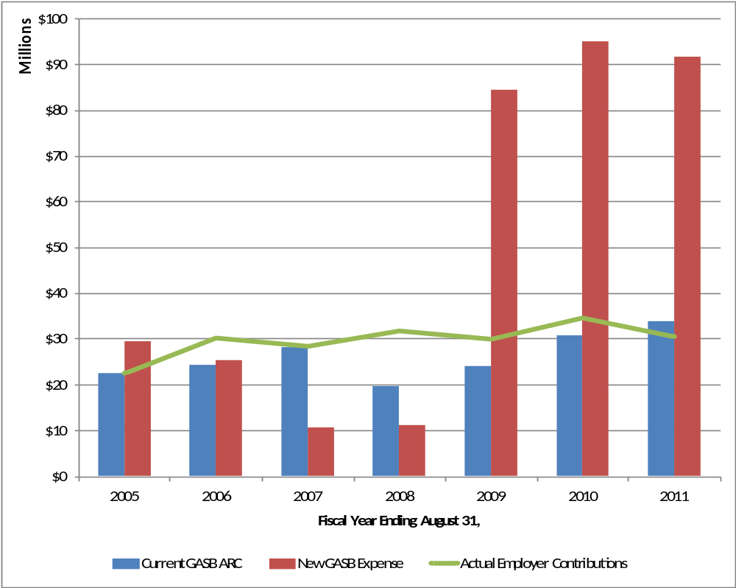
New GASB Pension Expense vs.
Current GASB ARC

Slide 12
PE as Funding Level?
New funding guidelines will have to be developed for plans.
The PE cannot be used as it is a backwards looking number and, as shown on the previous slide, it generates much greater volatility.
In addition it could be an income item, and funds cannot be withdrawn from the trust.

Slide 13
Revised Statements 25 (now 67) and 27 (now 68)
Deferred Inflows and Outflows (DI/O) created.
  Accounts that hold the unrecognized changes in NPL.
  Separate line item not included in assets or liabilities but shown on the face of the balance sheet.
Extensive footnote disclosure and supplementary information required. For example (10-year schedules are built prospectively with the exception of the ADEC schedule):
  10-year schedule of changes in NPL
  10-year schedule of TPL, Fiduciary Net Position (FNP) and NPL
  10-year schedule of, if calculated, Actuarially Determined Employer Contributions (ADEC) and actual employer contributions
  10-year schedule of money-weighted actual rates of return net of investment expenses
  Method used to determine the long-term investment return rate
  Real rates of return by asset class and whether they are arithmetic or geometric returns.

Slide 14
Revised Statements 25 (now 67) and 27 (now 68) (cont.)
Probably require two actuarial reports, one for funding and one for accounting.
Possible involvement of multiple actuaries for systems, employers and auditors.

Slide 15
Calculation and Reporting Timing and Frequency - Plans
Reporting Date (RD) – plan’s fiscal year end
Measurement Date (MD) – date as of which TPL, FNP and NPL are determined – is the RD
Valuation Date (VD) – date as of which total pension liability (TPL) is determined
  Actuarial valuations must be at least biennial
  No earlier than 24 months from RD
  If VD before RD then TPL is rolled forward to RD

Slide 16
Calculation and Reporting Timing and Frequency - Employers
Reporting Date (RD) – employer’s fiscal year end
Measurement Date (MD) – date as of which TPL, FNP, NPL, PE and DI/O are determined
  No earlier than previous fiscal year end
  NPL and PE reported on RD without adjustment
Valuation Date (VD) – date as of which total pension liability (TPL) is determined
  Actuarial valuations must be at least biennial
  No earlier than 30 months plus 1 day from RD
  If VD before MD then TPL is rolled forward to MD
Timing is to be consistently applied so choose well!

Slide 17
Timing
No more than 30 months
plus one day
No more than one year

Slide 18
Timing Examples
VD = MD = RD
  Most straightforward as long as there is sufficient time to complete the valuation before the financial statements are published
VD=MD < RD
  NPL, PE and DI/O measured by the valuation are reported without adjustment in the financial statements
VD < MD <= RD
  TPL calculated as of VD and rolled forward to MD
  FNP (market value of assets) measured as of MD
  Resulting NPL reported without adjustment in the financial statements
  PE and DI/O determined as of MD and reported without adjustment in the financial statements
  Most complicated timing situation, so avoid if possible

Slide 19
Timing Examples
Example #1:
  RD = 6/30/15 (employer’s fiscal year end)
  MD = 6/30/15
  VD = 6/30/15
Example #2
  RD = 6/30/15
  MD = 6/30/14
  VD = 6/30/14
Example # 3
  RD = 6/30/15
  MD = 6/30/14
  VD = 6/30/13

Slide 20
Recognition of Significant Changes
Significant changes include:
  Unusual change in liabilities or assets
  Benefit changes
  Size or make-up of membership
  Change in municipal bond rate used to determine the discount rate
  Anything else that significantly affects the valuation results (e.g., assumption changes)
If the change happens between VD and MD, then it must be recognized in NPL as of MD.
If the change happens between MD and RD, it must be disclosed along with the impact, if known (e.g., legislative changes that have fiscal notes).
If the change happens after RD, but before financial statement is issued, it must be disclosed as a subsequent event.

Slide 21
Timing of Significant Changes
If change occurs here
recognize in NPL
If change occurs here
disclose as
subsequent event
If change occurs here
disclose change and
impact if available

Slide 22
Assumed Investment Return
Based on long-term expected return of assets held in trust unless fund is expected to be depleted before all benefit payments are made.
  Long Term ROR is net of investment expenses but gross of administrative expenses (administrative expenses will be included in the asset projection as an additional cash outflow item).
If that is the case then a blended single rate that is the equivalent of the long-term rate while assets are available and a municipal bond index for the remaining period.
  Municipal bond index is general obligation non-taxable 20 year bonds with AA/Aa or higher rating.

Slide 23
Projecting Assets
In determining whether a single equivalent rate must be calculated, assets need to be projected into the future.
Project benefit payments for the closed group of plan participants as of the VD.
For employer contributions two conditions are checked:
  Contributions set statutorily or contractually?
  Contributions subject to formal, written funding policy?
If either condition is met, then look to the past five-year history of compliance and adjust as necessary for the projection.
If neither condition is met, then use a five-year average of actual contributions, as a dollar amount, a percent of payroll or a percent of the actuarially determined employer contribution (ADEC).
Cannot count normal cost contributions for future hires, but can recognize any UAL payments made based on future hire payroll.
No “safe harbor” provided for this determination but there is a bow to the possibility that potential asset depletion date might be calculated through “other” methods.

Slide 24
Interest Rate Example

Slide 25
Ad-hoc COLAs
Ad-hoc COLA’s that are “substantively automatic” must be included in determining the Total Pension Liability.
In determining this, the historical pattern of granting the changes and the consistency in the amounts are taken into account.
Offsetting these would be any evidence that the changes might not continue on the future.
Who makes the call? Decision is unclear.

Slide 26
Deferred Retirement Option Plans
(DROPs)
DROPs are plans that permit employees to freeze their retirement benefit and have the monthly amount contributed to an account while they continue to work. At actual retirement the frozen benefit commences and the balance in the DROP account is paid out in a lump sum.
In determining NPL and PE, entry into DROP should be treated as a retirement exit from active status.
Active members in DROP on VD should be treated as retired
(i.e., inactive).
Plan Net Position should include DROP account balances as of MD (with the exception of amounts due but not yet paid).
Logical conclusion then is that the DROP account balances should be included in the TPL.

Slide 27
Cost-Sharing Employers
Employers will need to report proportionate share of NPL, PE and DI/O.
Proportionate share is the individual employer’s projected long-term contribution effort as compared to the total plan contribution effort.
If this is not easily obtained, the share may be determined using a basis associated with the manner in which the employer’s contractually required contributions are assessed. For example, if all cost-sharing employers contribute at the same rate of pay, then presumably the ratio of the employer’s payroll to the plan’s total payroll could be used.
The impact of changes in the proportionate share from year-to-year will have to be determined and amortized in the same manner as actuarial gains/losses.

Slide 28
Cost-Sharing NPL Impact
Sample School Districts
 | #1 | #2 | #3 | #4 | #5 | #6
Total Estimated NPL | $76,709,611 | $209,591,599 | $62,337,561 | $71,830,106 | $18,431,322 | $34,571,117
Total Employer Assets | $104,409,196 | $158,363,276 | $27,718,581 | $47,329,758 | $14,565,179 | $34,599,111
Net Asset (Deficit) or Surplus after booking NPL | $27,699,585 | ($51,228,323) | ($34,618,980) | ($24,500,348) | ($3,866,143) | $27,994
Ratio: NPL to Total Employer Assets | 73.5% | 132.3% | 224.9% | 151.8% | 126.5% | 99.9%

Slide 29
Special Funding Situations
Some plans receive contributions from entities other than the employer. These are referred to in the Statements as Governmental Non-employer Contributing Entities (GNCEs).
A GNCE is not required to report any portion of NPL, PE or DI/O if:
  The GNCE has no legal obligation to contribute, or
  The GNCE’s contribution requirement is defined by a dedicated revenue stream.
If one of those conditions is not met, then the GNCE must assume and report a proportionate share of the NPL, PE and DI/O, in a manner similar to that determined for cost-sharing plans.

Slide 30
Final Thoughts
The disclosure requirements for both the plan and employers are significant.
The effective dates provide some time to develop the templates that will be needed as well as to give GASB staff time to hopefully produce an implementation guide.
The changes may not have a big impact on balanced budget requirements, but will most likely affect loan and banking covenants.
There do not appear to be any requirements that plans provide detailed information to employers. For cost-sharing employers, who does what will have to be worked out.

