Slide 1
2013 Southern Conference on
Teacher Retirement
Accounting and
Actuarial Challenges
for PERS Today
April 22, 2013
Presented by:
Thomas J. Cavanaugh, FSA, FCA, MAAA, EA
CEO
Cavanaugh Macdonald Consulting, LLC

Slide 2
Actuarial Issues
GASB’s authority extends only to accounting and financial reporting, not to funding.
New Statements necessitate a fresh look at funding policies and actuarial techniques.
Projections will play a bigger role going forward, particularly for all the plans with multiple benefit tiers.

Slide 3
Pension Expense as Funding Level?
The simple answer is NO!
New funding guidelines will have to be developed for plans.
The PE cannot be used as it is a backwards looking number and it tends to generate much greater volatility.
In addition it could be an income item, and funds cannot be withdrawn from the trust.

Slide 4
Evolution of Modern Public Pension Plan Financing 1970 - Today
1970s – the decade of the actuary
  Beginning of automatic cost-of-living adjustments (COLAs). Social Security’s COLA was effective in 1975.
  Move to higher equity participation by plans. For some plans it was the beginning of equity investments.

Slide 5
State and Local Government Asset Allocation
(Federal Reserve Board of Governors Flow of Funds
1955 – 4th Qtr 2012)

Slide 6
Evolution of Modern Public Pension Plan Financing 1970 - Today
1980s and 1990s – decades of the investment consultant
  Increased equity participation. Previous slide shows increase from 22% in 1980 to 64% in 2000.
  Great total fund returns.
  Actuaries took a back seat as funding got “easier” and “easier”.

Slide 7
Evolution of Modern Public Pension Plan Financing 1970 - Today
Late 1990s and 2000s – the decade plus of the accountant
  GASB issues Statements 25 and 27 setting de facto funding standards via the Annual Required Contribution (ARC).
  Actuaries (who were already in the back seat ) moved to the trunk.
  Actuaries took the easy way out and blamed everything on the accountants (and to some degree we’re going to keep doing that!)

Slide 8
Evolution of Modern Public Pension Plan Financing 1970 - Today
2010s and later (?) – decades of the actuary
  GASB has abdicated any role in funding guidance. They now just want a spreadsheet number or two.
  Investment consultants are in a defensive posture as returns are low.
  Actuaries have to step (and are stepping) back up to the plate.
    American Academy of Actuaries Public Plans Subcommittee
    Conference of Consulting Actuaries Public Plans Community
    California Actuarial Advisory Panel issued “Actuarial Funding Policies and Practices for Public Pension and OPEB Plans” February 2013
      Model practices
      Acceptable practices
      Acceptable practices, with conditions
      Non-recommended practices
      Unacceptable practices

Slide 9
Need for a Funding Policy
Pre-funding is less expensive over the long term than pay-as-you-go.
It provides retirement security.
It’s consistent with accrual accounting.
A funding policy statement describes how the Board of Trustees intends to provide secure retirement benefits.
Its development will increase the Board’s understanding of the risks involved and the underlying actuarial funding principles.

Slide 10
Funding Policy Structure
There are normally three major components of a funding policy statement:
  Funding Goals
  Benchmarks
  Methods and Assumptions

Slide 11
Funding Goals
The goals describe the objectives the Board has in funding the benefits.
Some common goals are:
  Full funding (100% funded ratio)
  Contribution rate stability
  Intergenerational equity
  Targeted funding ratio, either greater than or less than 100%

Slide 12
Benchmarks
The benchmarks indicate how progress toward meeting the stated goals with be measured. They can include:
  Funding ratio
  Experience test (ratio of net gain/loss to accrued liability over time)
  Short condition test (assets compared to retiree liability and active member contribution balances)
  Contribution rate history
  UAAL amortization period

Slide 13
Methods and Assumptions
The following elements are usually addressed in funding policy statements:
  Actuarial cost method
  Asset smoothing method
  Amortization of Unfunded Actuarial Accrued Liability (UAAL) policy
  Funding target

Slide 14
Actuarial Cost Method
Still several acceptable methods
  Entry Age Normal
  Projected Unit Credit
  Aggregate
  Frozen Initial Liability

Slide 15
Asset Smoothing Method
Issues include:
  Length of smoothing period.
  Corridor and, if one, it’s size.
  Fixed or rolling smoothing periods.
ASOP 44 requires a method that:
  Is likely to return to market in a reasonable period and likely to stay within a reasonable range of market, or
  Has a sufficiently short period to return to market or sufficiently narrow range around market.

Slide 16
Amortization of UAAL
Open or closed period.
Level percent of payroll or level dollar.
Separate amortization by source of UAAL.
Length of amortization period.
Somewhat dependent on whether employer contribution rates are fixed or not.

Slide 17
Funding Ratio Comparison

Slide 18
Funding Target
The ultimate funding target should be 100% or more at some point in the future.
How that is accomplished and over what timeframe will be dependent on both statutory restrictions and the funding goals established by the Board during the policy setting process.
Projections can play a major role in measuring progress toward whatever funding goal is established, particularly with tiered benefits.

Slide 19
Projections and Tiered Benefits
It’s common now to have two or more tiers of benefits in public plans.
This creates a front-loaded benefit structure and potentially a back-loaded contribution structure.
The front-loading is fairly obvious as new tiers provide lower benefits to new hires than previous tiers do.
The back-loading can occur for plans that contribute a fixed or increasing employer contribution rate, either by statute or by policy.

Slide 20
About Projections
Annual actuarial valuations are a “snapshot” of the financial position on the valuation date, based on the existing active and retired members.
Projections simulate future actuarial valuation results over a forecast period (generally 20-50 years depending on the situation) by “creating” future new hires and performing valuations using the projected membership.
Benefit changes from new tiers are reflected for the affected employee groups as they become effective.
Deterministic projections use one set of demographic and economic assumptions over the projection period. Stochastic projections provide results of thousands of runs under randomly determined assumptions (usually economic).
Projections provide information on trends in financial measurements. They do not provide absolute results.

Slide 21
Discount Rate Comparison
Funded Ratio - PERS

Slide 22
Discount Rate Comparison
Amortization Period - PERS

Slide 23
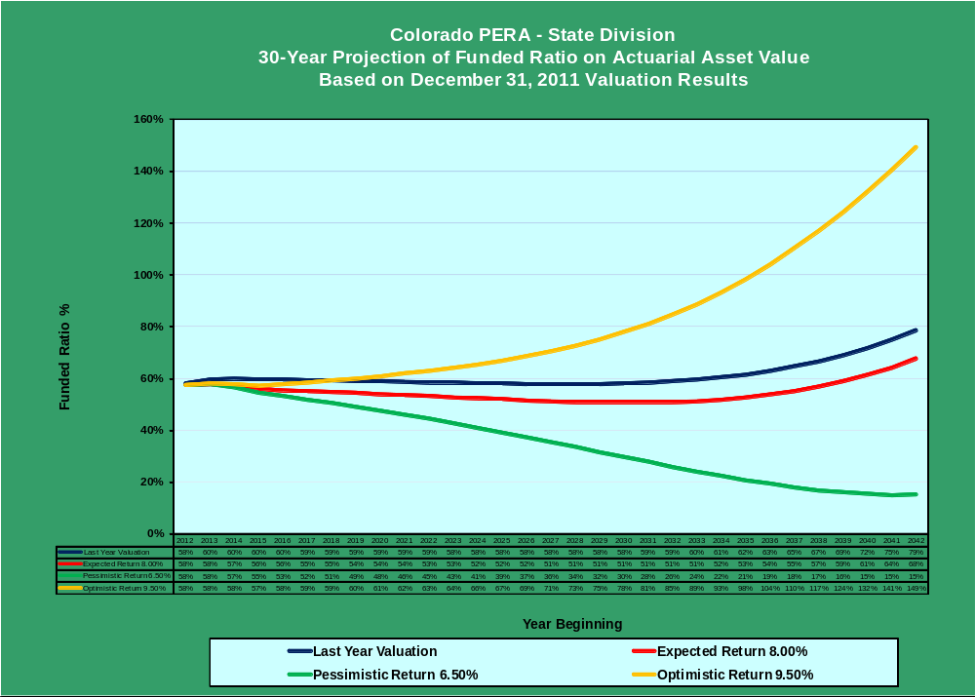

Slide 24
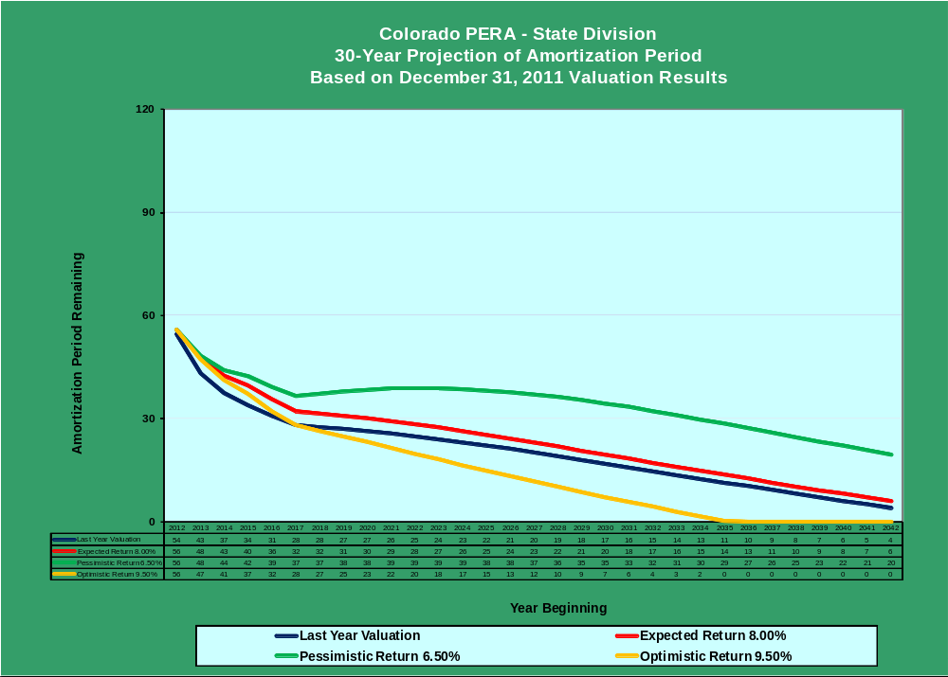

Slide 25
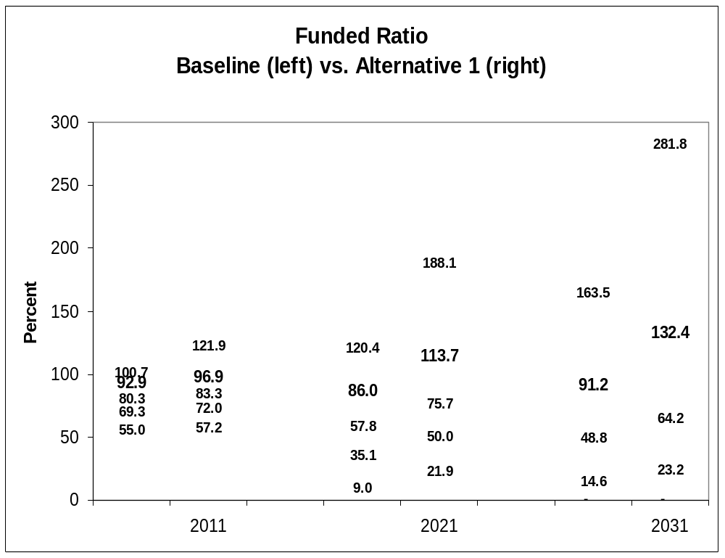
Stochastic Projection Results
Funded Ratios

Slide 26
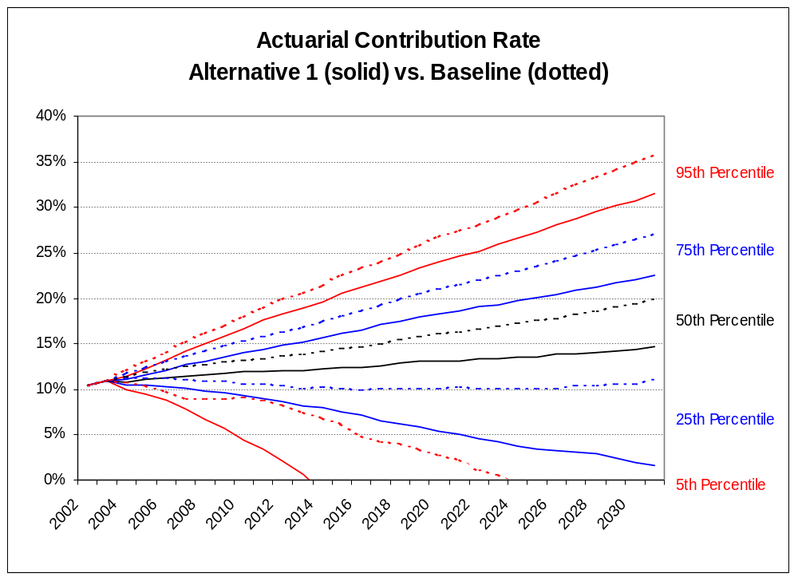
Stochastic Projection Results
Contribution Rates

Slide 27
Final Thoughts
Unlock your trunk and let your actuary out!
Develop a funding policy now to address the need you will have once GASB 67/68 are effective.
Valuations are fine but projections are finer. Consider adding them to the annual flow of information from your actuary.

